Slide 1
The American Revolution
Significant Events and Impact

Slide 2
Siege of Boston
After Lexington and Concord, 20,000 armed Patriots surround Boston
Gives Washington time to send men to Ticonderoga to win artillery
Battle of Bunker Hill (June 17, 1776)
General Thomas Gage decides to kick Patriots off of place called Breeds Hill
Assault was brutal but British win battle because Patriots run out of ammunition
British lose 2400 troops, Patriots only use 400
Dorchester Heights (January 1776)
Henry Knox arrives with cannon

Slide 3
Impact of Siege of Boston
March 1776 British abandon Boston
Most go north toward Canada
More than 1000 loyalists leave with them
Summer 1776 General Howe arrives in New York

Slide 4
Battle of Long Island
400 British ships arrived carrying 32,000 British Troops and Hessian mercenaries
Washington had 10,000 untrained soldiers
http://www.history.com/topics/american-revolution/battle-of-long-island

Slide 5
Impact of battle of Long Island
Continental Forces retreat from Manhattan
George Washington realizes he needs a new battle plan to fight the British

Slide 6
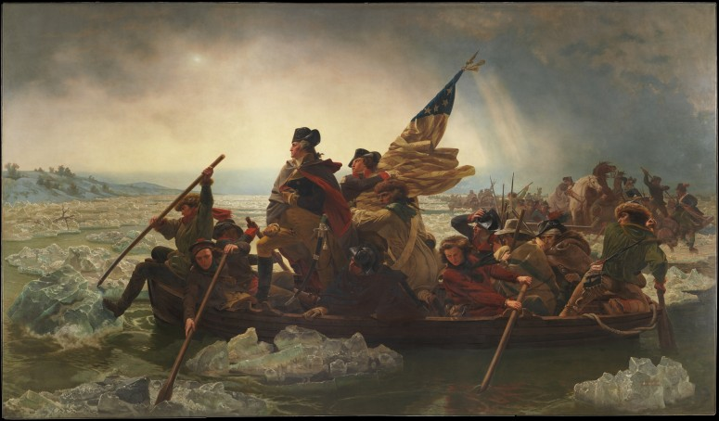
Battle of Trenton
Washington abandon’s traditional fighting methods and decides to fight in the winter
Christmas night of 1776, 2400 troops left Pennsylvania and crossed the Delaware River
Capture almost the entire Hessian force and Americans only suffer 5 casualties

Slide 7
Impact of the Battle of Trenton
Boosted Patriot morale and convinced more Americans to support the Patriot cause
http://www.history.com/topics/american-revolution/battles-of-trenton-and-princeton/videos/george-washington-makes-surprise-attack-on-trenton
(Funny Video) https://www.youtube.com/watch?v=OTdcdrMWySQ

Slide 8
Battle of Saratoga
General Burgoyne marches south from Canada, but they move slow
Mid- September Horatio Gates attacked Burgoyne numerous times
October 17, 1777 Burgoyne surrenders near Saratoga New York

Slide 9
Impact of Battle of Saratoga
Major turning point in the war!
Victory brings foreign allies to the American side
http://www.history.com/topics/american-revolution/american-revolution-history/videos/battle-of-saratoga-turns-the-tide-of-the-american-revolution

Slide 10
Hardships at Valley Forge
Best example of Americans' determination to be free!
Patriot army spends the winter huddled in huts with few blankets, ragged clothing and almost no food
1/3 of the 10,000 troops were unfit to fight because they lacked coats and shoes
https://www.youtube.com/watch?v=3iu_-0DjIJc

Slide 11
Impact of Valley Forge
Improved training during winter by Prussian general Friedrich von Steuben
Increased loyalty toward Washington both from his troops and the Continental Congress
Improved morale of troops

Slide 12
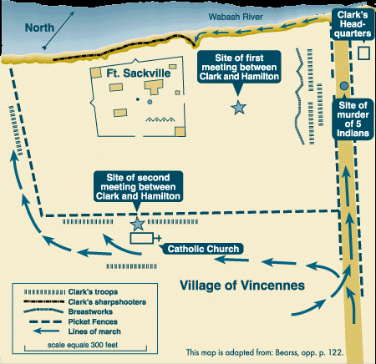
Fighting in the West
Spring 1778 George Rogers Clark began fighting in the west with the help of 175 French settlers and Native Americans
By winter he had support from 500 troops who marched through snow. Mud and ice to capture Ft. Sackville

Slide 13
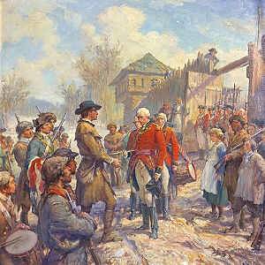
Impact of Fight in the West
Strengthened Patriots claim to the Ohio River Valley
Gained increased access to the Mississippi
Strengthened ties with Native Americans who decided to fight with the Americans instead of the British

Slide 14
Battle of Yorktown
Southern battles were vicious, lots of loyalist support
August- British General, Lord Cornwallis set up camp in Yorktown waiting for the Navy to arrive
Lafayette blocked British from being able to escape over land
French Navy Arrives and Washington’s troops arrive to join the French
French navy blocks the British Navy, Cornwallis doesn’t get his reinforcements
https://www.youtube.com/watch?v=SWZy3zRbBHI

